Slide 1
Data Visualization
Love, Noah Elbaum

Slide 2
Project Structure
Find a data set that was interesting to me
Ask 4 questions about it that would require me to learn new techniques for using Seaborn and manipulating data
Make 4 graphs to answer those questions
Present!

Slide 3
Where I started…
CSV of Stack Overflow Developer Survey
73,268 respondents in 2022
Data from 2011 through 2022
Found on stack overflow website
Pandas library for creating/manipulating dataframes (read: “data tables”)
Seaborn library for graphing data, built on matplotlib library (also for plotting data)

Slide 4
How has the popularity of each operating system changed through time?
Data collection challenges:
csv format not standard throughout years (different csv for every year)
Raw data -> dictionary -> initial dataframe -> normalized dataframe -> graph
Graph used: line plot
X-axis: year
Y-axis: percent of respondents who reported using that operating system
The right graph shows the percentage of Linux users who used each distribution of Linux

Slide 5
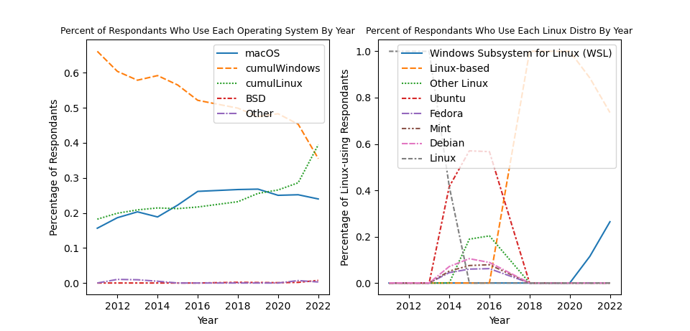

Slide 6
Are older people working with older programming languages?
Using just one csv, I again made a dictionary and then a dataframe because the cell of the csv was a semi-colon separated list
Columns of dataframe were each language, rows were age groups, values were counts
I rearranged the languages and age groups to be ordered in a logical way
Graph used: heatmap
X-axis: languages, newer languages on the left and older languages on the right
Y-axis: age groups, each cell of the heatmap is the percentage of the age group that codes in the language
Color: lighter color means higher percentage of the age group uses that language

Slide 7
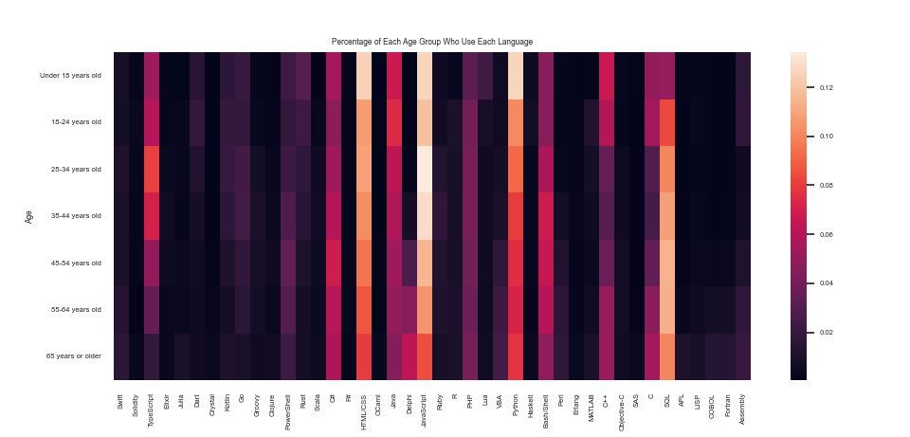

Slide 8
Where do developers get paid the most?
Because there are so many countries, I had to select just the ones with the highest average reported salaries
I disqualified countries that had less than 11 datapoints
Graph used: box plot(s)
X-axis: country
Y-axis: salary, converted/standardized to a yearly salary by stack overflow in csv
The leftmost box plot is for the United States of America

Slide 9
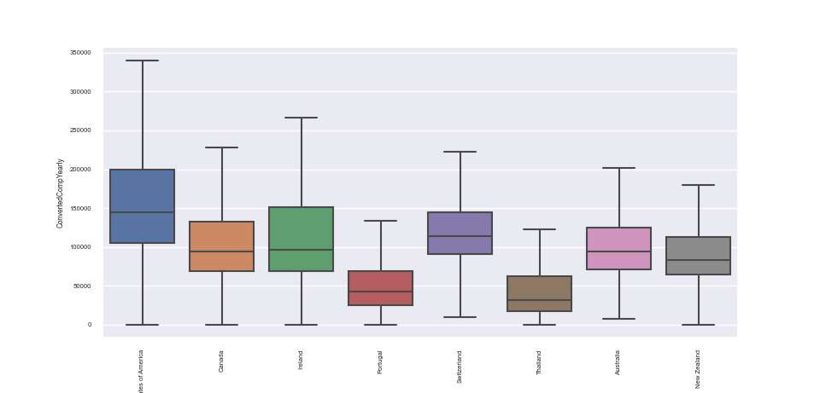

Slide 10
Is there a correlation between a developer’s work experience and their salary?
I used subplots to show this correlation, set the limit on the y-axis, and set the opacity of a graph
I learned to replace pesky non-integer values with their integer counterparts so seaborn could graph the data
Graph(s) used:
Top left: KDE plot, shows where most of the values are concentrated (erroneously shows negative values for salaries because of the way the KDE formula works)
Top right: violin plot showing distribution of work experience in the data
Bottom left: linear regression line showing correlation between experience and salary
Bottom Right: all 3 previous graphs overlaid on top of each other
Y-axis: salary (for all except the violin plot which doesn’t have a meaningful y-axis)
X-axis: work experience

Slide 11
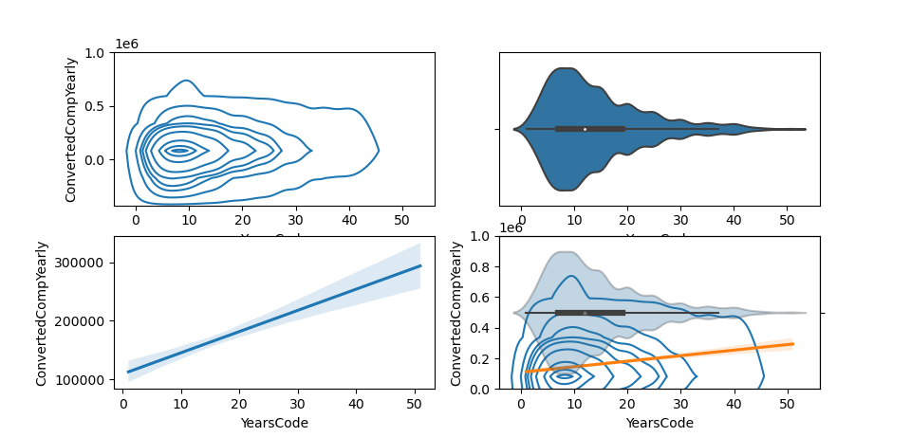

Slide 12
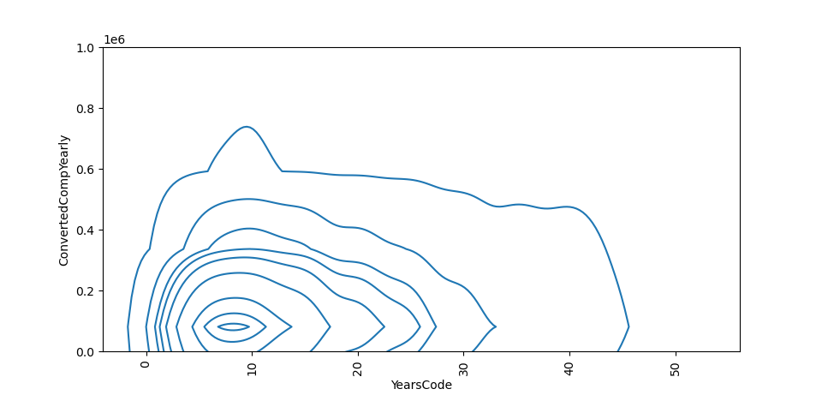
Let’s investigate this KDE plot further…

Slide 13
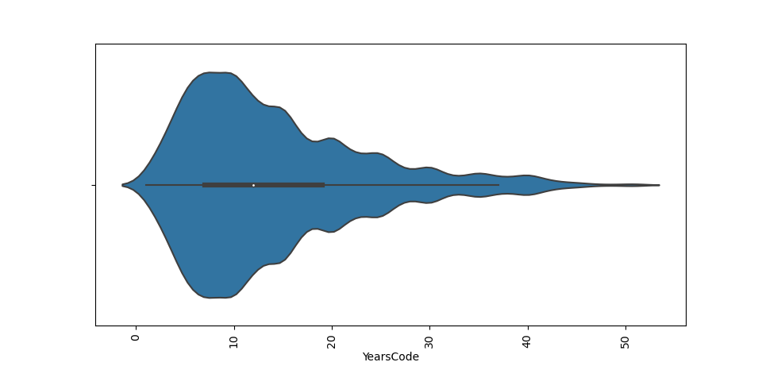
…and what does this violin plot mean?

Slide 14
Where I would’ve gone next…
If I could collect my own data (and travel back in time), I would’ve collected more data in the early years of the survey to track more variables over time
If I could know exactly how stack overflow converted people’s salaries, I would’ve seen if they converted them all into USD or not
I would’ve tried to figure out how each country’s currency is doing based on the developer salaries
I would’ve tracked trends across gender, but there was not time in this project to do so

Slide 15
Please applaud

